Slide 1


Student Success at the Farmer School of Business
By: Riley Nguyen, Drew Nanda, Magda Odrowaz & Matt Smuda
Notes:
Drew 1-6 & 23-25
Matt 7-11 & 26-end
Magda 12-18
Riley 19-22

Slide 2


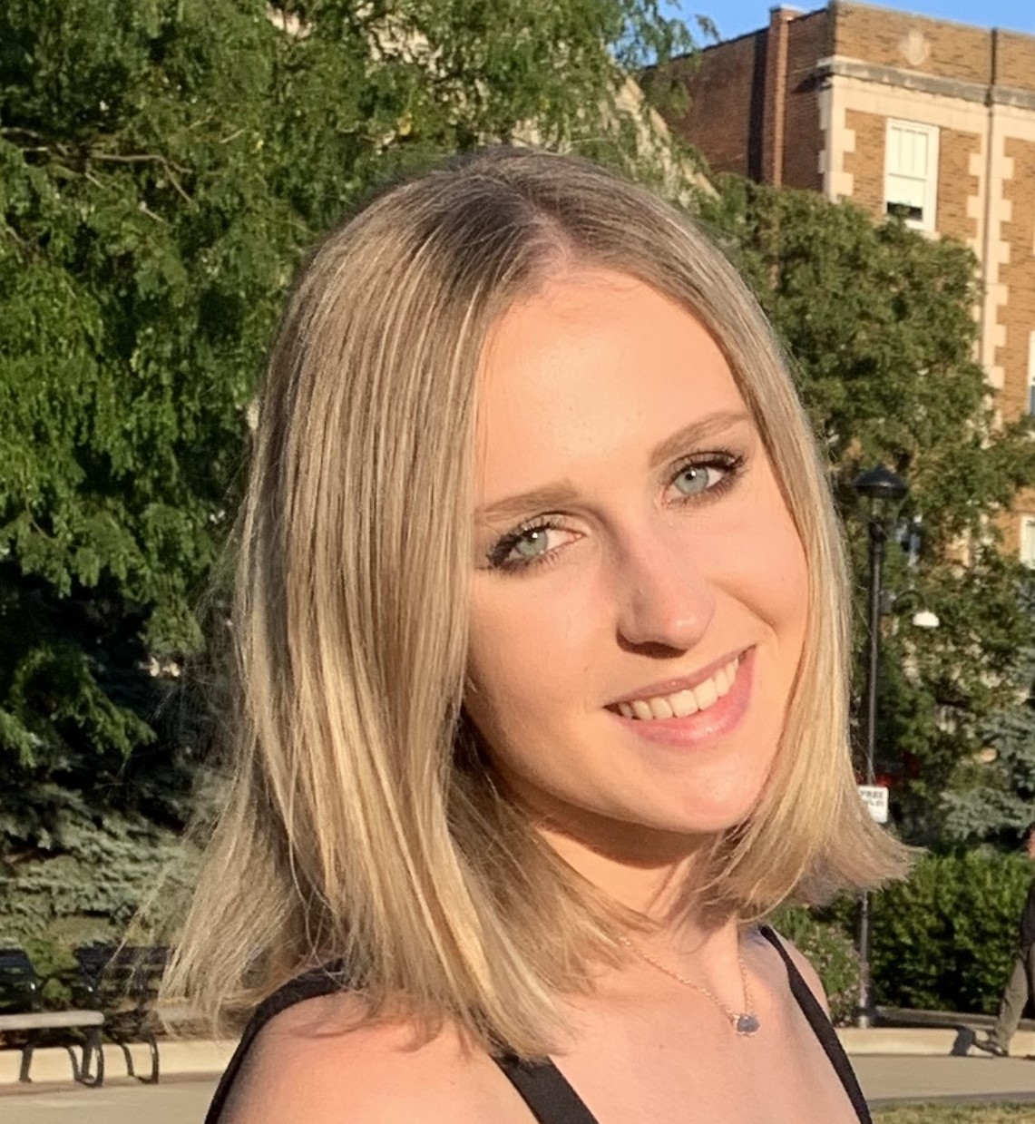
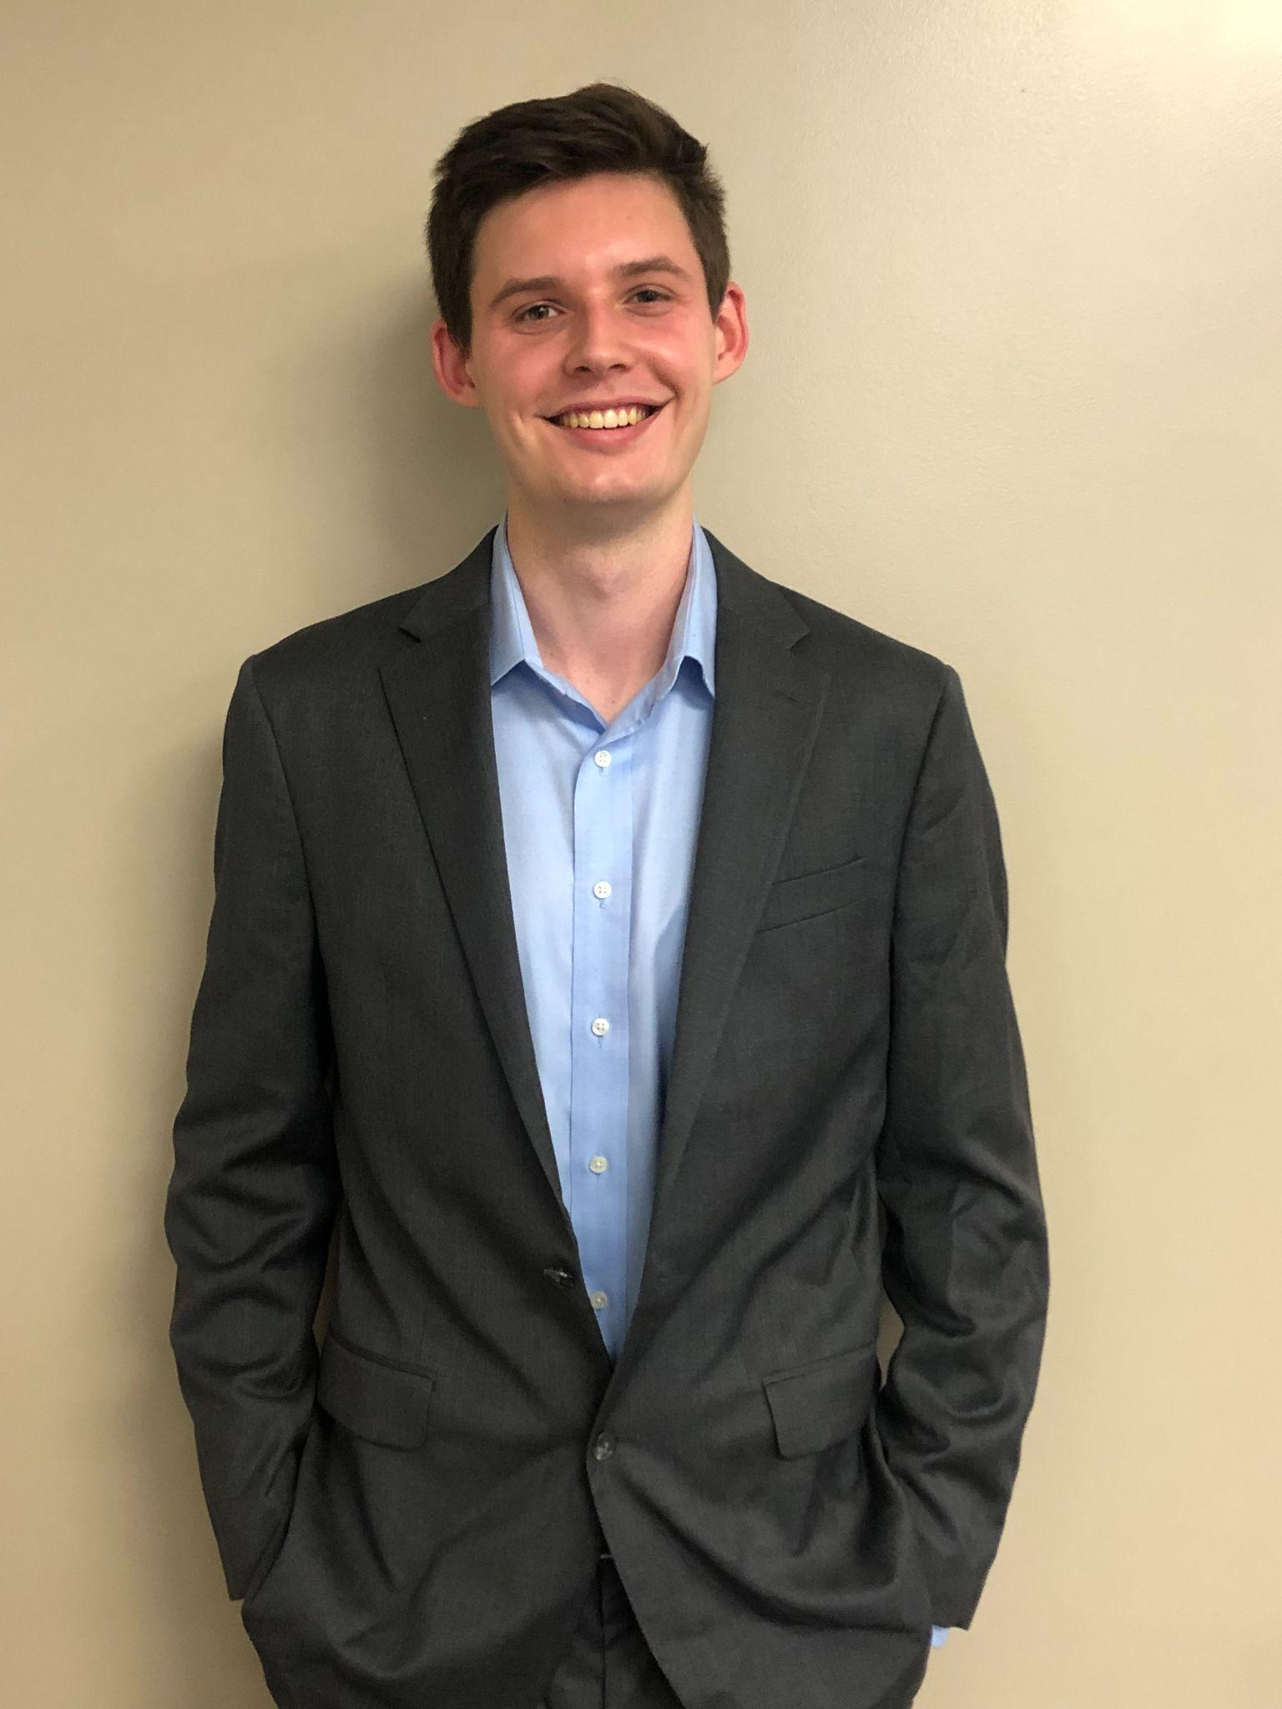

The Team
Riley Nguyen Ho Chi Minh, Vietnam
B.S. Business Analytics ‘23
M.S. Business Analytics ‘23
Drew Nanda
Beavercreek, OH
B.S. Marketing ‘22
M.S. Sports Analytics ‘23
Magda Odrowaz
Buffalo Grove, IL
B.S. Kinesiology & Health ‘22
M.S. Business Analytics ‘23
Matt Smuda
Palos Park, IL
B.S. Finance ‘22
M.S. Sports Analytics ‘23
Notes:
This is not magda’s official photo please note (Or Matt’s)

Slide 3
Agenda:
1
2
3
4
5
6
Introduction & Project Scope
Research Questions
Modeling
Analysis
Discussion
Conclusion
Notes:
Drew

Slide 4
1. Introduction and Project Scope
Notes:
Drew

Slide 5

Background & Project Scope
Academic Advising
Currently…
No process to identify at-risk students
Use of anecdotal evidence to support best practices
Introduction
Research
Modeling
Analysis
Discussion
Conclusion
Notes:
FSB prides itself on preparing students for real world business careers through rigorous coursework and enriching hands on experiences. Specifically, the Student Success Advising team prides itself on supporting students throughout their studies at the FSB through academic advising, Such advising is currently steered by anecdotal evidence and lacks a process for supporting the most students as possible, as well as promoting their success.

Slide 6
Background & Project Scope
Definition of Success:
Graduation from the Farmer School of Business within 6 years (12 terms)
Introduction
Research
Modeling
Analysis
Discussion
Conclusion
Notes:
Drew

Slide 7
2. Research Questions

Slide 8
Project Goals
A definition of student success
Analysis and modeling to identify and predict successful and at-risk students
Tableau Dashboard
Logistic Regression Model
Reproducible workflow
Introduction
Research
Modeling
Analysis
Discussion
Conclusion

Slide 9
Research Questions
How can a metric for student success be defined at the Farmer School of Business?
What major-level, course-level, and student-level attributes are most related to success criteria of graduating with an undergraduate degree within 6 years (12 semesters)?
What recommendations can be made to improve the efficacy of academic advising?
Introduction
Research
Modeling
Analysis
Discussion
Conclusion

Slide 10
3. Modeling
Notes:
Add Data description?

Slide 11
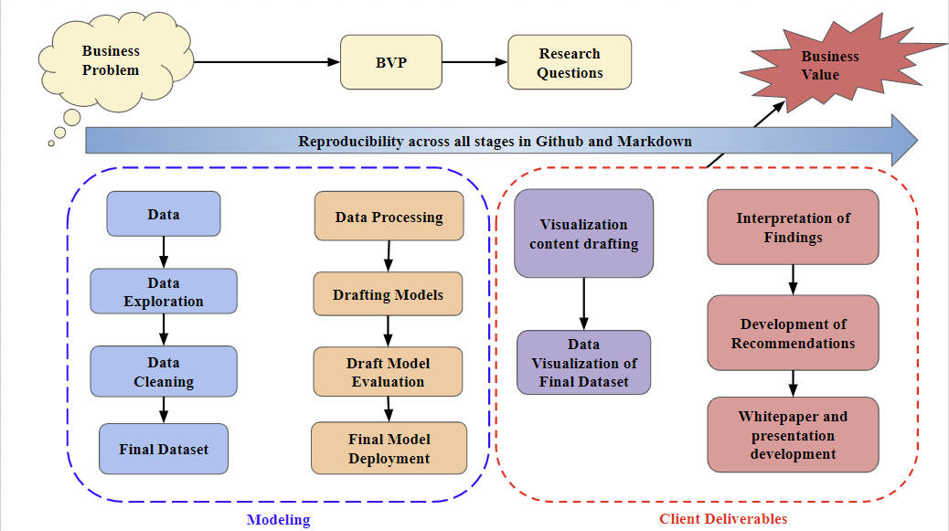

Slide 12
4. Analysis

Slide 13
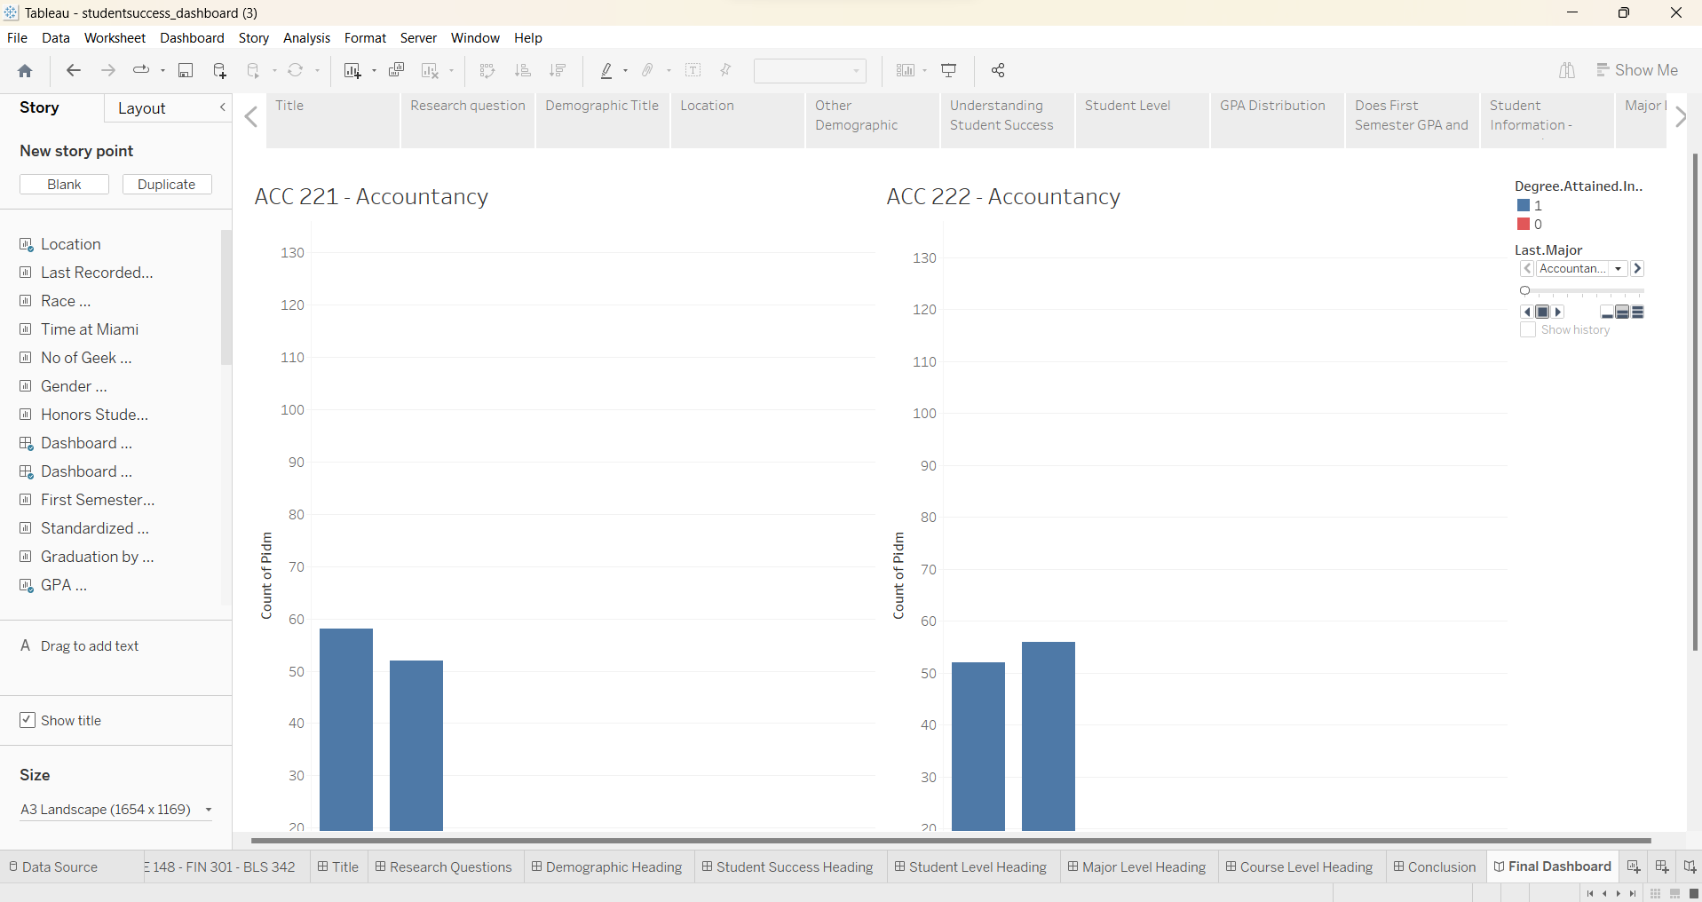
Analysis Tools:
Dashboard: Tableau
Modeling: R in RStudio (version 4.1.2) Python in Jupyter Notebook (version 3.8.5)
Introduction
Research
Modeling
Analysis
Discussion
Conclusion
Notes:
ex)
Python
Logistic regression
Python packages used
Tableau
Github and markdown explanation

Slide 14
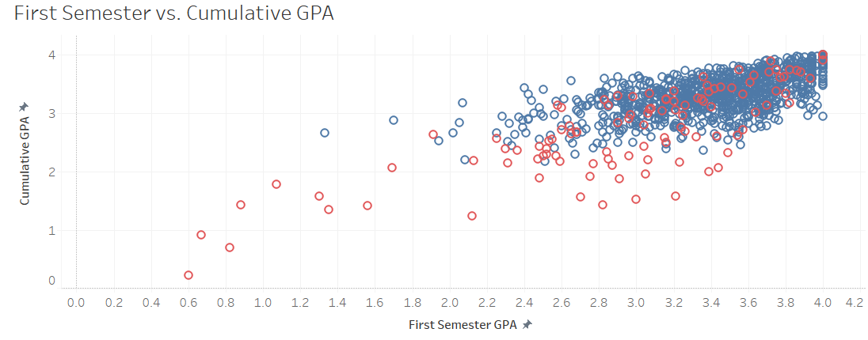
Exploratory Analysis: Student Level
Degree attained
Degree NOT attained
Introduction
Research
Modeling
Analysis
Discussion
Conclusion
Notes:
Students that had good first semester GPAs and standardized test scores (SAT or ACT) were more likely to graduate with higher GPAs
Students that struggle in the first semester (GPA wise) are likely to not earn their degrees. However, there is still little to no pattern between these attributes and their graduations.

Slide 15
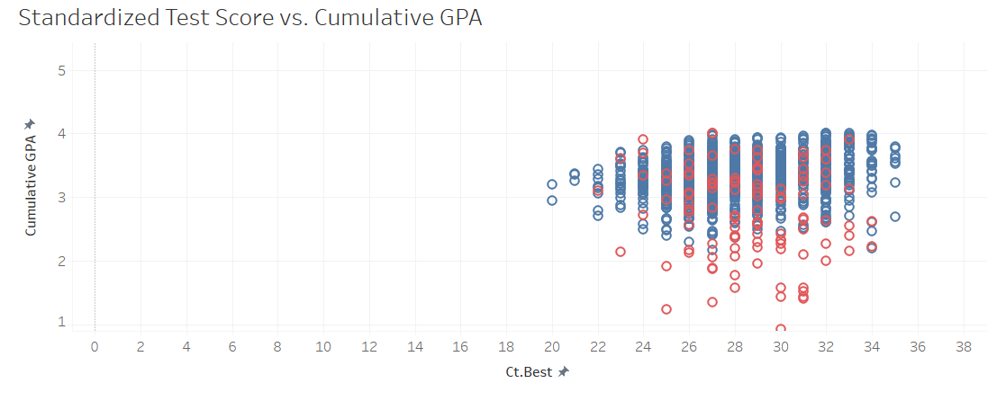
Exploratory Analysis: Student Level
Degree attained
Degree NOT attained
Introduction
Research
Modeling
Analysis
Discussion
Conclusion
Notes:
Students that had good first semester GPAs and standardized test scores (SAT or ACT) were more likely to graduate with higher GPAs
Students that struggle in the first semester (GPA wise) are likely to not earn their degrees. However, there is still little to no pattern between these attributes and their graduations.

Slide 16
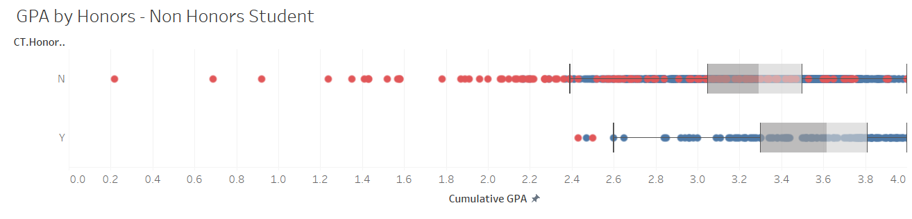
Exploratory Analysis: Student Level
Degree attained
Degree NOT attained
Introduction
Research
Modeling
Analysis
Discussion
Conclusion
Notes:
As expected, most of the honors students tend to earn their degrees. Only 2 of them did not. This is also consistent with what we found in our model.

Slide 17
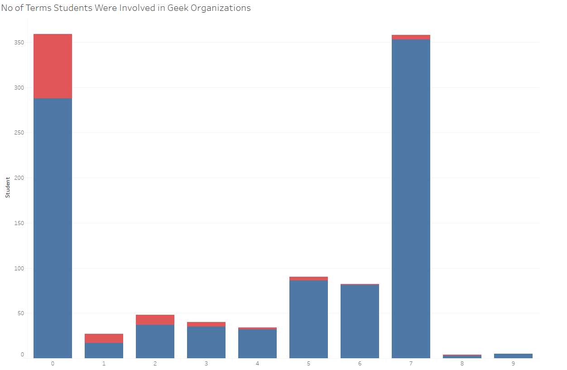
Exploratory Analysis: Student Level
# of Terms in Greek Life versus Student Count
25% of students that were not involved in Greek life did not earn their degrees
Student Count
Degree attained
Degree NOT attained
# of Terms in Greek Life
Introduction
Research
Modeling
Analysis
Discussion
Conclusion
Notes:
What is interesting is students that did not spend time in a Greek org seem to be more likely to not get their degrees.

Slide 18
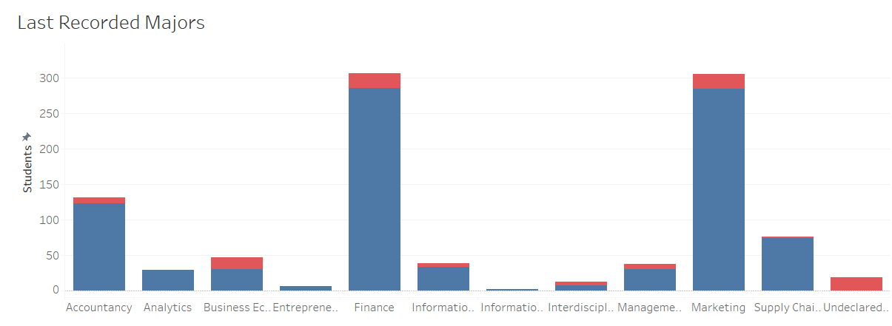
Exploratory Analysis: Major Level
Degree attained
Degree NOT attained
Introduction
Research
Modeling
Analysis
Discussion
Conclusion
Notes:
Based on the last major recorded for our students, the majority of FSB students in this class were Finance or Marketing major. Every major has some students that did not earn their degrees. However, Econ seemed to have a lot of students that did not graduate, if you think about it proportionally.

Slide 19
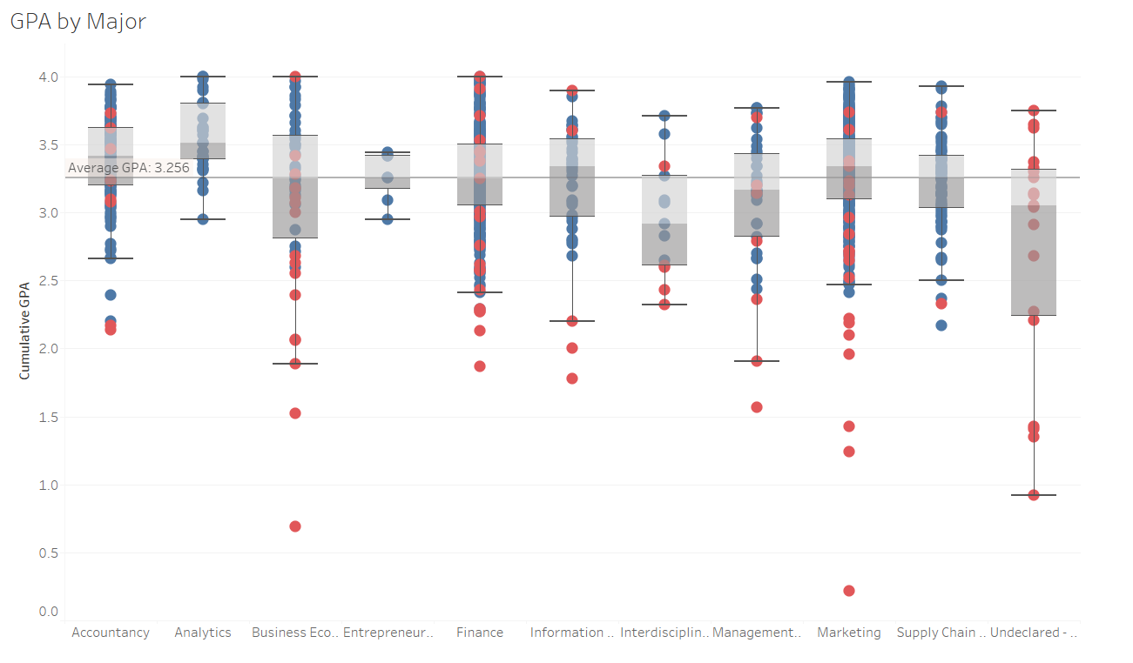
Exploratory Analysis: Major Level
Degree attained
Degree NOT attained
Introduction
Research
Modeling
Analysis
Discussion
Conclusion
Notes:
Magda send help :) I guess consistent with the last graphs, we have finance and marketing having a lot of students that did not earn their degrees (due to their large class size). H

Slide 20
Model: Logistic Regression
Degree attained —
Probability of Degree Attainment
Degree NOT attained —
X
Introduction
Research
Modeling
Analysis
Discussion
Conclusion

Slide 21
Model: Logistic Regression
First semester GPA
ACT Score
No. Terms in Greek Organization
Core course grades
Residency
Distance from home
Logistic Regression Model
Probability of Degree Attainment
Introduction
Research
Modeling
Analysis
Discussion
Conclusion

Slide 22
Model Performance
Degree attained
Specificity: the proportion of students that did not earn a degree and were classified as so - HIGH
Accuracy: the proportion of students that were classified correctly - HIGH
Mis-classification: the proportion of students that were classified incorrectly - LOW
Degree NOT attained
Degree attained
Degree NOT attained
Introduction
Research
Modeling
Analysis
Discussion
Conclusion

Slide 23
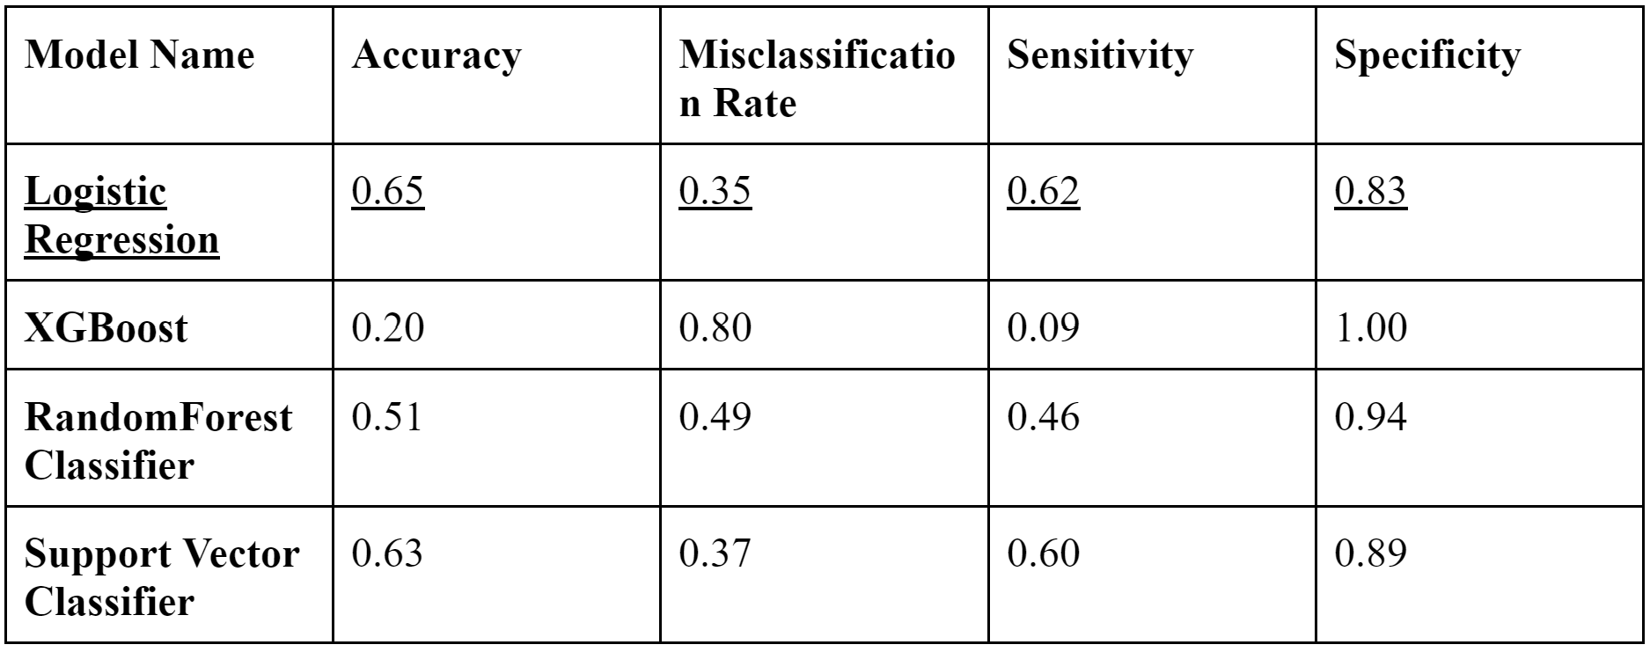
Model Performance
Introduction
Research
Modeling
Analysis
Discussion
Conclusion

Slide 24
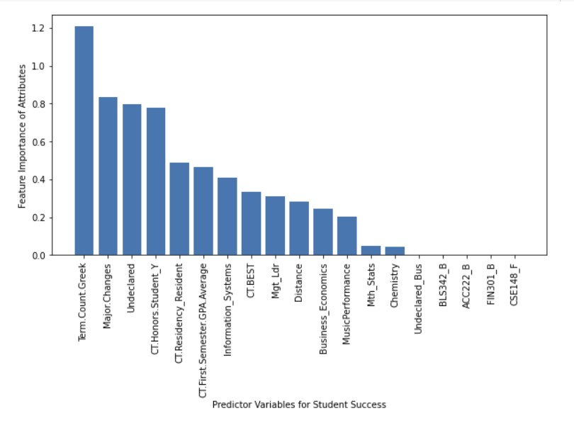
Feature Importances of Student Success Attributes
Introduction
Research
Modeling
Analysis
Discussion
Conclusion

Slide 25
Feature Importances of Student Success Attributes
Name of Attributes | Odds Ratio
Number of Terms a Student is Involved in Greek Organizations | 3.623
Number of Major changes | 2.4
Having an Undeclared Major | 2.255
Being an Honors Student | 2.103
Being an Ohio Resident | 1.666
Introduction
Research
Modeling
Analysis
Discussion
Conclusion
Notes:
https://quantifyinghealth.com/interpret-logistic-regression-coefficients/

Slide 26
5. Discussion
Notes:
Drew

Slide 27
Limitations
Lack of external factors
Student employment
Student satisfaction
Data failed to fully encapsulate:
High school academic performance
Social and family life
Financial considerations
Certain variables dropped from analysis for the purpose of modeling
High correlation
Uniform values
Large amount of missing information
Introduction
Research
Modeling
Analysis
Discussion
Conclusion
Notes:
Drew

Slide 28
Recommendations
Expand career exploration initiatives
Encourage major changes and undeclared degree paths, so that they can explore different options
Advocate for and support student engagement in social organizations
Social and professional fraternities/sororities
Potentially academic focused organizations
Introduction
Research
Modeling
Analysis
Discussion
Conclusion
Notes:
Drew

Slide 29
6. Conclusion

Slide 30
Conclusion
Provided FSB Student Success team with:
A definition of success
A model that can predict at-risk students based on specified attributes
A dashboard providing a visual exploratory analysis of student attributes
A reproducible workflow
R Markdown - Python
Tableau Template
Github
Data backed interpretations based on our findings
Introduction
Research
Modeling
Analysis
Discussion
Conclusion
Notes:
https://public.tableau.com/views/studentsuccess_dashboard/FinalDashboard?:language=en-US&:display_count=n&:origin=viz_share_link

Slide 31
Thank You!
Notes:
https://public.tableau.com/views/studentsuccess_dashboard/FinalDashboard?:language=en-US&:display_count=n&:origin=viz_share_link

